Slide 1
Agile Business Analysis
Peter Grüner, Yannick Nann & Simon Wild

Slide 2
The Start-Up Challenge
Opportunity identified
Students search for interesting jobs
Companies need skilled personnel
Opportunity: Skill-based matching platform
High-Level Idea drafted
Create an interface to connect education sector and economy
Act as middleman to match the open positions with existing skills of students
Prerequisite: Cooperation with educational institutions and companies

Slide 3
Demand for an agile approach
Scope
Functions and Focus of Platform
What value proposition
Which kind of service
What (Scope)
Solution
Link between schools and industries
Broad Idea of Platform
Team, Stakeholder
Core team is built
Collaboration partners are unknown and have to be identified
Customer segment
How
(Solution)
Who
(Team, Stakeholder)
Notes:
Scope
Value proposition
Service descriptions (Core services, value creating services)
What kind of service should be provided
In which state should it be provided
Solution
Broad idea to be the middle man between the education sector and the industries
Team, Stakeholder
Core team is known
Collaboration partners (Universities, Schools, Federal institute of Education) are unknown and have to be identified.
Customer segment

Slide 4
Benefits of the agile approach
Ideal involvement of all stakeholders
Integration of new insights along the go-to-market journey
Faster time to market due to MVP approach
Increased quality and customer centricity
Notes:
MPV – Software development
- Prototype to the solution

Slide 5
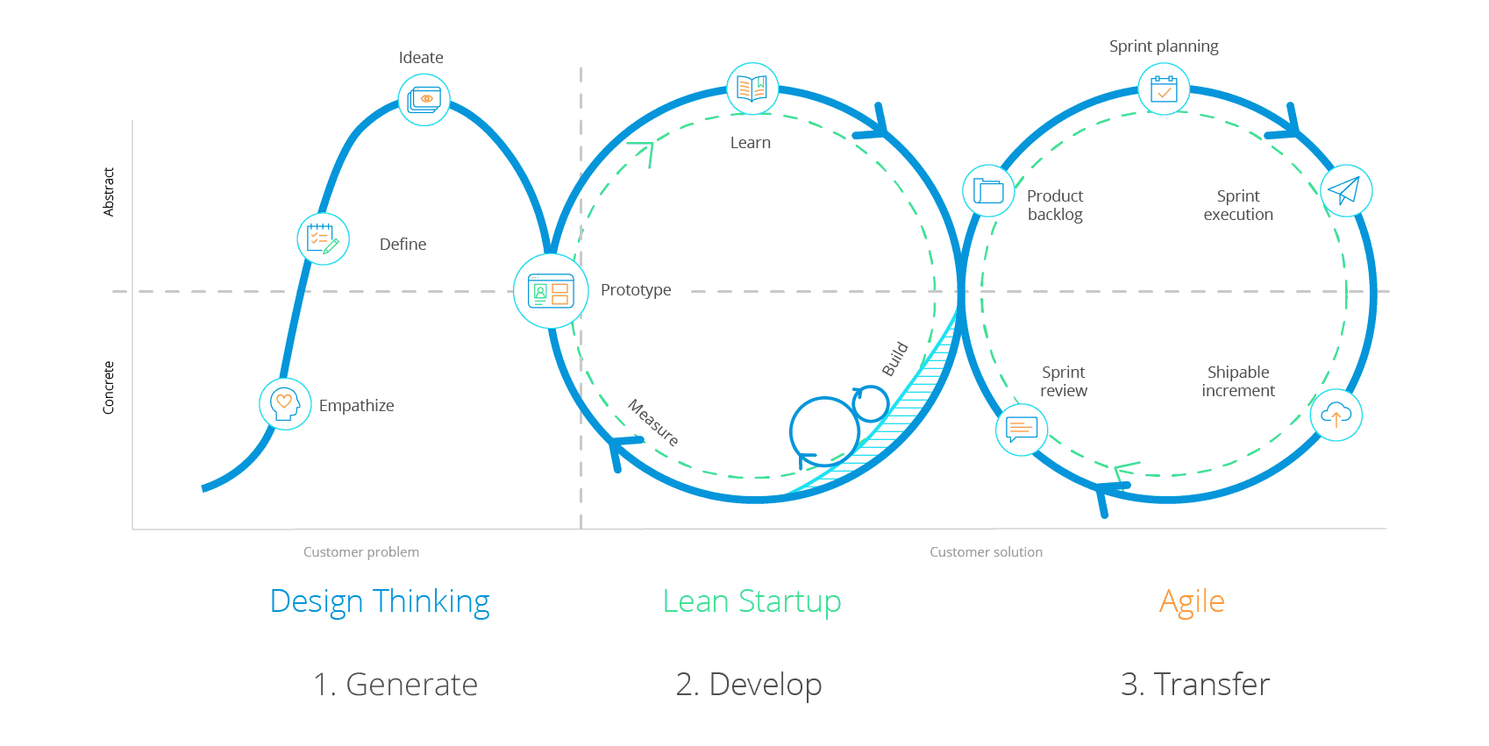
Combination of design thinking and agile
Business
Model
Platform Prototype
CI/CD
Services
Go to market

Slide 6
Expected objectives
Design Thinking Iteration
Business Model
Customer Segment
Value Proposition
Agile Cycles
Platform Prototype
High-Level Requirements
High-Level Designs / Mock-Ups
Testing

Slide 7
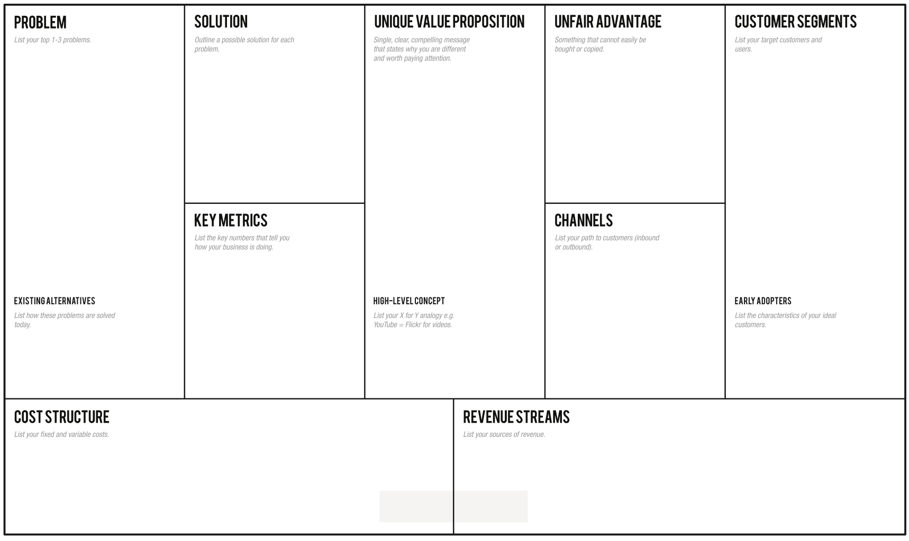

Slide 8
Business Prototype How the first year could look like
Backlog:
Design Thinking workshop to develop Vision & Mission and Roadmap
Investor Pitch with Story Telling & Prototype
Prototyping with Mock-Up
Get continuous customer Feedback

Slide 9
Vision
Vision
Provide the best and most convenient job searching and offering platform
Mission
Students find what they really want and what fits their skills
Companies find the best candidates for the job offering
Circular customer base
Universities get a feedback on which skills are needed
Extract the interests and skills as convenient as possible
Extract the desired skills form the job description
Build the customers future path through our service
Goal 4
Goal
Sentiment analysis
Career analysis
Sector analysis
Experience analysis
Profiling the companies
Sentiment analysis
Crawling the offerings
Example path of a customer
UX and UI
Recommendation
DP
Implicit and explicit data analysis
Machine learning
Web crawling
Machine learning
Workshop
Methods

Slide 10
Vision
Vision
Provide the best and most convenient student on-boarding platform
Mission
Access to Swiss wide student data
Goal
Design
Principle
Methods

Slide 11
Scope of the Project
Develop the Services of the start up
Precise service description
Interface between the universities and the platform
Mock-Ups of the platform
Marketing
Corporate design and identification
Develop a catchy and appealing pitch

Slide 12
Core Business Process Overview

Slide 13
Approach

Slide 14
Reasons for agile approach
New Insights can change the

Slide 15
Roadmap
Sprint 1
Sprint 2
Sprint 3
Sprint 4
MVP
Corporations
Service description
Students
Idea finding
Brain storm
Start-Up
Sustainability

Slide 16
Roadmap
First go to market 2O20
Connect the first students to matching jobs
Revaluate the strategy 2020 Q3
Interface and matching v2.0 2021
Feedback form the early birds
Swiss wide presents
International partnership 2022
Start the first international partnerships with universities
5000 Matches
200 Matches
First quantitative milestone
Aggressive expansion strategy
First big iteration in regards of user interface, branding and algorithm
The service can be offered at every university in Switzerland

Slide 17
Story Job mapping Platform
Process
Task
Sign up
Complete information
Search for a job
Inspect the job
Decide on the job
Apply
Start the job
Sign up page
Add more preferences
Simple search
Read about the job
Yay or No button
Matching skill
Physical interview
Sign up with Social media
Fine tune the skills
Advanced search
Link to the website
Comparing jobs
Show contact info
Sign up with FH / Uni
Review the information
Matching rate
Show on map
3th party sign-up
Bookmark job

Slide 18
Back up
Process
Task
Sign up
Complete information
Search for a job
Inspect the job
Decide on the job
Apply
Start the job
Release 1
Sign up page
Release 2
Release 3
Quarter 1
Quarter 2
Quarter 3
Quarter 4

